Slide 1

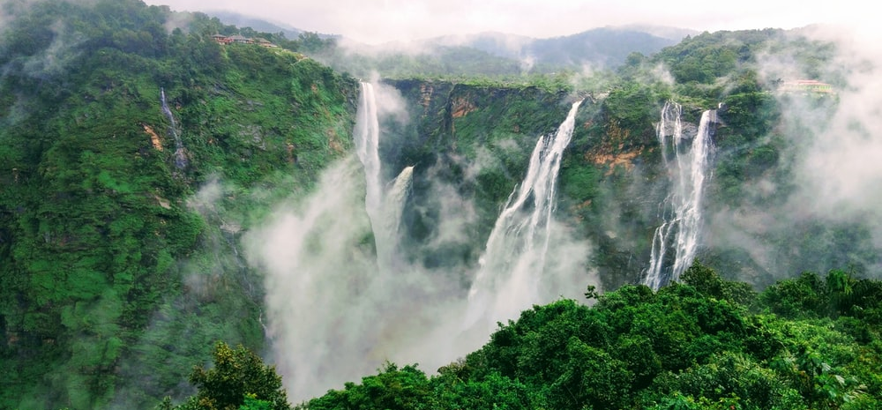
Tourism management system

Slide 2
This project is done under the guidance of Prof. Kishor Sakure
Group members are :
Shweta Kaware (A-06) (TU3F1920005)
Karishma Bairi (A-15) (TU3F1920014) (Group Leader)
Nupoora Shinde (A-22) (TU3F1920021)
Ketki Kulkarni (A-53) (TU3F1920053)

Slide 3
Agenda
Introduction
Aim & Objective
Abstract
Literature Review
Methodology
Hardware & Software Requirements
Conclusion
References

Slide 4
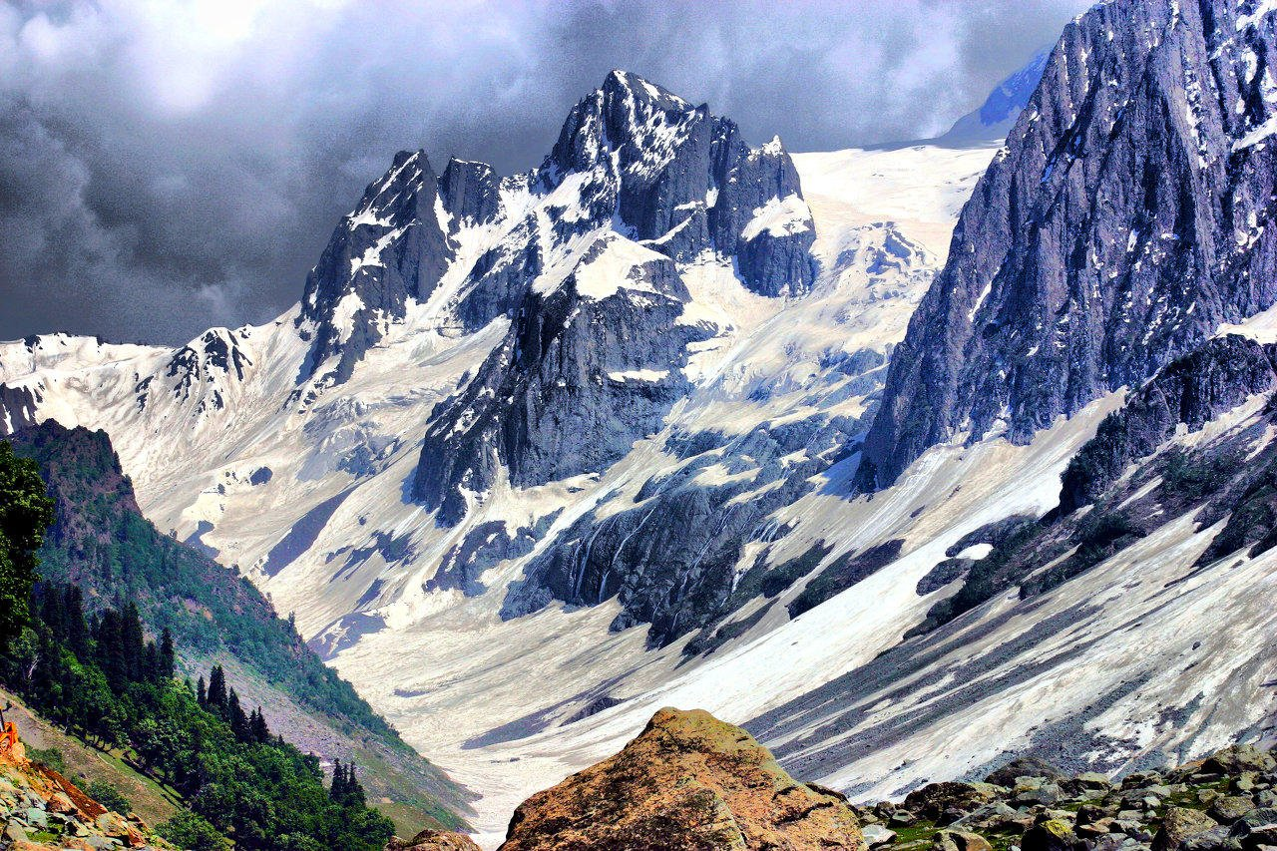

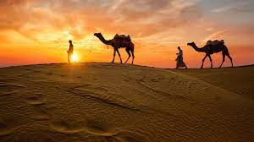
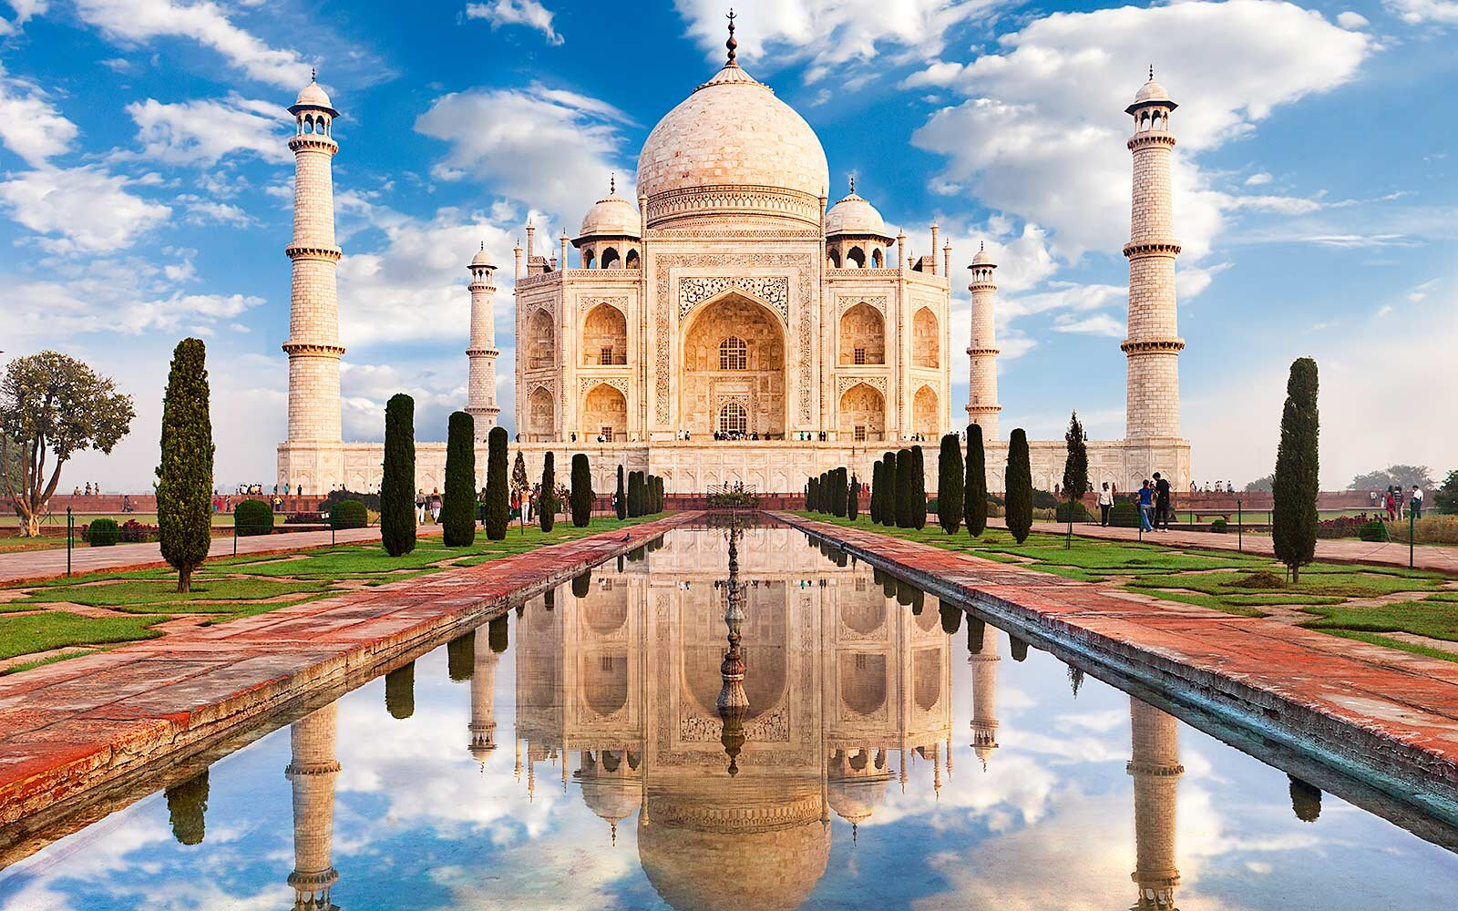
introduction
Kashkenu Travel is an online system that utilizes the benefits of the internet to supply travel services starting from travel tickets to conveyance.
All users have access to an online portal to book their travel from few mouse clicks. Therefore by this all it proves that it's user-friendly.
As the result of the survey conducted, due to the intense number of human traffic, purchasing a train ticket manually is not merely a ten or twenty minutes task, but in fact, it can even take up to an hour or two especially during the peak seasons. The best option hence is to book everything online: train ticket, hotel and the further needed transportations.
The two main advantages of travellers are convenience and a more secure way of travelling.
Under the traditional system, most travellers have to carry physical tickets given to them from the counter at all time of travelling. With e-ticketing, all associated information will be stored digitally in a central database and therefore there are no chances of the traveller losing them or having them stolen.

Slide 5
AIM & OBJECTIVE
The main objective of our Project Tourism Management System is management of packages, travel mode, booking dates, customer verification and payment. The project is totally built at user end and therefore everyone has access but the logins can only be accessed by the registered user. The purpose of the project is to build website which reduces the manual work for managing the Travel, Tour and Customer.

Slide 6
ABSTRACT
Kashkenu Travels is a web-based application that enables travellers check for travel package availableness, book a train or flight ticket, which also includes stay at hotels. The aim of this Travel website is to automate the existing manual system by the assistance of computerized equipments and full-fledged computer software, fulfilling the necessities, so that their valuable data information may be stored for a extended amount with straightforward accessing and manipulation of an equivalent. The organization can maintain computerized records without redundant entries. Tools like HTML, CSS, PHP were used to develop Tourism Management System.

Slide 7
Literature review
Year | Author Name | Paper Name | Description
2018 | Joan Henderson | Study on Online Websites | This Tourism Management system was used to enhance the accuracy of bookings. It was used to book tickets without any discrepancies by saving customers information.
2016 | David Simmon | Book of Exploration | This Tourism Management System was developed in order to lessen the manual work. This online Tourism Management system helped customers to book packages easily online.

Slide 8
Year | Author Name | Paper Name | Description
2014 | Prof. Shweta K. Rao | Tours and Travels Designing | The analysis took into account the travelling group composition. The results showed that, for the total tourist sample, overall satisfaction had the biggest influence on the decision of whether to revisit a destination.
2012 | Bennet Mathew | Web Application Research | The main purpose was to help tourism companies to manage customer and hotels etc. The system could also be used for both professional and business trips.
2010 | Mirjha Gupta | My Web Application | Tourists were satisfied with cultural attractions and amenities of but mainly they were satisfied with the cultural attractions.

Slide 9
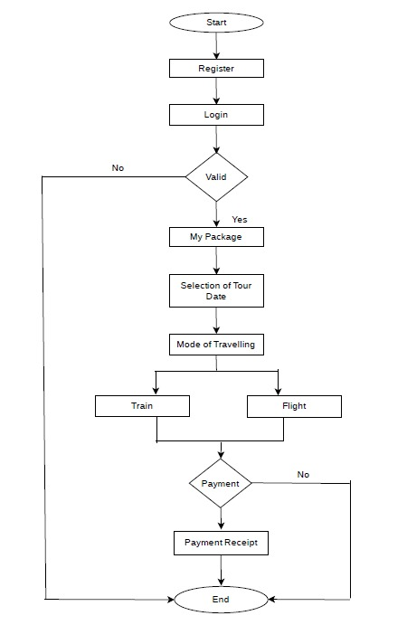
Methodology (Block diagram)
This block diagram describes the working of Tourism Management System.
It is an connecting link between the user and database.
User interacts with the system and database stores information regarding the customer and its bill.
When you start the web application, it asks you to Register if you haven’t already or you can simply Login if you are an existing user.
On the successful Register or Login, you can go to My Packages to explore the various Travel Packages.
Then after selecting your desired Package, you can select the date of the travel from 3-4 options as per your convenience.
Further, you are supposed to select the Mode of your travel i.e. either Train or Flight.
For confirming your reservation, you have to make the payment as displayed for that particular package.
After the successful payment, you will receive an e-mail on registered e-mail id, which will include the payment receipt with all the details.

Slide 10
HARDWARE & SOFTWARE REQUIRENMENTS
Hardware Specification
RAM : 4GB
Software Specification
Any windows operating system
Google Chrome extension

Slide 11
CONCLUSION
After we have completed the project we are sure the problems in the existing website would have overcome. The "Tourism Management System" process made computerized to reduce human errors and to increase the efficiency. The main focus of this project is to lessen human efforts and to get the correct information about a customer along with proper booking and payment details.
This website can be simply utilized by the customers and is powered with extremely customizable strong options to fulfill each demand of our customers.
It also verifies customer id and generates payment receipt which is mailed to the customer's registered mail id for the confirmation of payment.

Slide 12
REFERENCES
https://pdfcoffee.com/tourism-management-system-project-report-on-pdf-free.html
https://www.slideshare.net/mobile/MILTONKHAN2/tour-management-system
https://www.researchgate.net/publication/305426547_Intelligent_Tourism_Management_System
https://www.sciencedirect.com/science/article/pii/S2590005620300059

Slide 13

Thank You

